Slide 2
Oral Statements
Oral statements or discussion during the Pre-Submittal Meeting will not be binding, nor will it change or affect the RFQ or the terms or conditions within the contract. Changes, if any, will be addressed in writing only via an Addendum.

Slide 3
Presentation Overview
SMWVB
Key Dates
Addendums
Submittal Preparation
Evaluation Criteria
Selection Process
Contract Requirements
Communication Reminders
Questions
RFQ Objective
Project Overview
Key Considerations
Cost Estimates

Slide 4
SMWVB

Slide 5
Aspirational SMWVB Goal

Slide 6
SMWVB Requirements
SMWVB Certification accepted from the following entities:
South Central Texas Regional Certification Agency
Texas H.U.B.
RFQ Scoring:
Up to 15 Points
Local Office
Small Business Enterprise (SBE)
Minority Business Enterprise (MBE) (Includes ABE, AABE, HABE and NABE) (NABE)
Woman-owned Business Enterprise (WBEs): (Includes ABE, AABE, Caucasian, HABE and NABE)

Slide 7
Good Faith Effort Plan (GFEP) FAQs
Q: Is the 40% SMWB goal mandatory?
A: No, but it is weighed in the selection criteria, and SAWS asks Respondents to do their best with good faith outreach efforts. If the goal is not met, proof of outreach efforts is required with the submittal.
Q: What if I am having trouble finding SMWB subconsultants?
A: Please email the SMWVB Program Manager with the scopes of work you are seeking. You will receive lists of local SMWVB-certified firms to contact from the SCTRCA database.
Q: What if my business is SMWB-certified?
A: If your firm is SMWB-certified, you will most likely meet the goal. However, the GFEP is a required document, and a good faith outreach effort is still necessary.
Q: Do I need to include all subconsultants in the GFEP, or just SMWB-certified subconsultants?
A: All subconsultants need to be included in the GFEP. The GFEP and organizational chart need to match.

Slide 8
Post Award: S.P.U.R. System
Subconsultant Payment Tracking
Subconsultant addition, substitution, or removal requests

Slide 9
SMWVB Questions
Questions related to the SMWVB Program, completion of the Good Faith Effort Plan (GFEP), or scoring of the GFEP may be directed to the SMWVB Program Manager until the RFQ is due.
Marisol V. Robles
SMWVB Program Manager
Email: Marisol.Robles@saws.org
Telephone: (210) 233-3420

Slide 10
CONTRACT
ADMINISTRATION

Slide 11
Key Dates
Project Notice to Proceed
January 2020
Questions Due
September 13, 2019
Answers Posted by SAWS
September 18, 2019
SAWS Board Consideration
January 2020
SOQs Due
September 27, 2019
@ 2:00p.m.
Interviews
(if necessary)
October 2019
Contract Negotiations
November 2019
* The dates listed above are subject to change without notice

Slide 12
Addendums
Register as a vendor with SAWS Vendor Registration and Notification, if you have not done so already.
More than one (1) Addendum may be posted.
Check SAWS website often and prior to submitting a proposal for this RFQ.

Slide 13
Submittal Preparation
Submit hard copies (1 original and 8 copies)
Include a USB flash drive of the original proposal (all pages)
Reference the RFQ to determine what additional items are required (e.g., Organization chart)
Must submit using Evaluation Criteria Forms as indicated
Use 8 ½ x 11 portrait format (except where indicated)
Use Arial font, 10 pt. size. Do not change
Pay attention to page limits (where indicated)

Slide 14
Submittal Preparation
Thoroughly read and be familiar with RFQ
Maximize points by addressing all items identified in the RFQ
Be very specific and avoid “boiler plate” responses for all forms, tables and narrative
Utilize the Submittal Response Checklist
Contact the SMWVB Program Manager (Marisol Robles) for assistance, if necessary
Perform QA/QC on proposal prior to submitting

Slide 15
Submittal Preparation
Submittal deadline is Sept 27, 2019 at 2:00 p.m.
Solicitation number, solicitation name, date and time of the deadline should be clearly identified on the outside of the package.
Deliver to 2800 U.S. Highway 281 North, Customer Service Building.
Deliver to Counter Services
SAWS recommends submitting proposal at least two (2) hours prior to the deadline
Make arrangements early if mailing a response
Late responses will not be accepted and will be returned unopened.

Slide 16
Evaluation Criteria
Criteria | Max Points | Max Pages
Team Experience and Qualifications | 20 | 8
Similar Projects and Past Performance | 25 | 5
Project Approach | 30 | 5
Quality Management Plan | 10 | 2
Small, Minority, Woman, and Veteran-owned Business (SMWVB) Participation | 15 | Exhibit “B”
TOTAL | 100 | 20

Slide 17
Evaluation Criteria
Team Experience and Qualifications (20 points)
Org. chart with proposed Key Personnel and Key Subconsultant(s) and percentage of time allocated for duration of project.
Describe team composition, role and responsibilities of team, teaming history, and proposed approach to ensure successful completion of project.
One (1) page resume each for: Project Manager (first), Design Team Lead(s), QA/QC Lead, Cost Estimator, Permitting Lead, SUE Lead, Geotechnical Lead, and Survey Lead indicating experience with projects relevant to scope of services with the RFQ.
Complete Sub-Consultant Table to identify role of Respondent and Subconsultant(s) (e.g., design, permitting, SUE, survey, cost estimating, QA/QC, risk management, etc.)

Slide 18
Evaluation Criteria
Similar Projects and Past Performance (25 points)
Using Project Table identify 5 similar projects completed within the past 5 years
Three (3) Projects for Prime Consultant (without Key Subconsultant)
Two (2) Projects by Prime or Key Subconsultant
Proposed Key Personnel that must have worked on the projects are:
Project Manager (Employee of Prime) – 2 of 5 Projects
Design Team Leads – 3 of 5 Projects
QA/QC Lead – 3 of 5 Projects
Cost Estimator – 3 of 5 Projects
If Key Subconsultants will perform a significant role, identify three (3) additional relevant similar projects completed within the past 5 years
Identify Key Personnel, who are part of the proposed team, and roles and responsibilities for projects listed.

Slide 19
Evaluation Criteria
Project Approach (Narrative) (30 points)
Narrative format with one (1) 11” x 17” page allowed
Team’s approach to managing risk between design related issues and constructability, as well as permits, coordination with stakeholders and external agencies, acquisition of easements, and maintaining schedule.
Team’s alternative innovative approaches to accomplish a more successful and timely project.
High-level project schedule with milestones (11” x 17”, if desired for clarity).

Slide 20
Evaluation Criteria
Quality Management Plan (10 points)
Narrative format with two (2) page limit
Describe QMP
Overview of quality control (QC) and quality assurance (QA) process
Plan for how design issues will be identified, tracked, and resolved
Describe how independent QA/QC team will review deliverables
QA/QC schedule
Respondent’s role compared to SAWS’ role
Approach to becoming familiar with local construction practices and requirements, standard products and material costs, local and regional market conditions, and conditions influencing design and construction
Describe process to develop accurate and complete OPCCs
Describe familiarity with AACE’s 17R-97 and 56R-08

Slide 21
Selection Process
Statements of Qualifications received and reviewed for responsiveness
Technical Evaluation Committee scores qualification statements based on established Evaluation Criteria
Good Faith Effort Plan (GFEP) evaluated and scored
Selection Committee will review scores and recommend award
Interviews held, if necessary
Negotiation with selected Consultant within fifteen (15) calendar days of receipt of Selection Letter
Board Award

Slide 22
Contract Requirements
Consultants will perform all project-related functions utilizing SAWS’ Contracts and Project Management System (CPMS)
Including adhering to specified service levels for the processing of Submittals, RFIs RFPs, COs, and applications for payment (scratch sheet, schedule, and redlines)
Design by selected consultant shall meet all of the latest applicable federal, state, and local rules and regulations as well as SAWS’ standards and preferences.

Slide 23
Communication Reminders
No communication regarding the RFQ with the following:
SAWS Project Manager
Any other SAWS staff, managers, directors, or VPs
City Council member or staff
SAWS Board of Trustees
From release of the RFQ to Board Award
Exceptions: SMWVB POC and RFQ POC

Slide 24
Questions
Should be submitted no later than September 13, 2019 by 4:00 PM (CDT)
Must be submitted in writing:
Contract Administration Department
San Antonio Water System
Roxanne Lockhart
Roxanne.Lockhart@saws.org
Fax: (210) 233-5218

Slide 25
PROJECT
OVERVIEW

Slide 26
RFQ Objective
To procure professional engineering services necessary to develop construction documents to construct the proposed DeZavala Elevated Storage Tank, part of the water master plan improvements, and transition the project to construction (bid phase, Board award, and construction).
Project must be managed, designed and constructed with the highest regard for cost, schedule and quality.

Slide 27
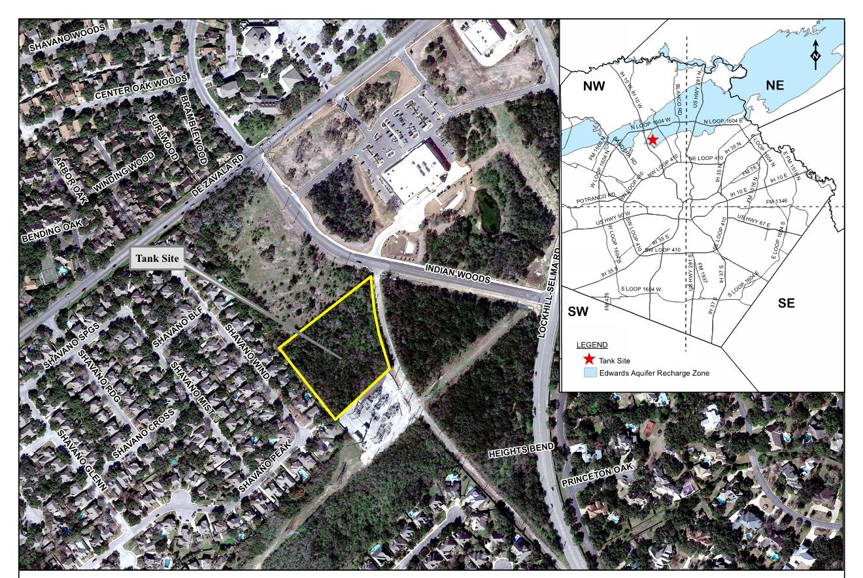
Overview

Slide 28
Key Considerations
Quality of Plans, Specifications, and Cost Estimates
Schedule and effective project delivery
Methods of construction
Coordination with other agencies (e.g., COSA, Bexar County, TxDOT)
ROEs, Easements, and ROW, as needed (Tank drainage piping)
SUE - Identification of utilities (above and below ground)
Surveys and topographic information (QA/QC)
Contractor Access, Project Sequencing, and Construction Milestones
Impacts to residents and businesses
Pavement and surface restoration, as needed

Slide 29
Cost Estimates – Design Phase
Consultant must develop Engineer’s Opinion of Probable Construction Costs (OPCC) for each phase (30%, 60%, 90%, and 100%) of the project as per the recommendations of AACE International as described in Recommended Practices No. 17R-97 and 56R-08.

Slide 30
Cost Estimates – Design Phase
Consultants to develop OPCCs for each design phase as follows:
Design Phase | Estimate Class | Expected Accuracy Range
30% Design | Class 3 | L: -5% to -15% H: +10% to +20%
60% Design | Class 2 | L: -5% to -10% H: +5% to +15%
90% Design | Class 1 | L: -3% to -5% H: +3% to +10%
Bid Documents | Class 1 | L: -3% to -5% H: +3% to +10%

Slide 31
Cost Estimates – Construction Phase
Consultants must provide independent cost estimates (ICEs) based on the RSMeans method of cost estimating by using the most current RSMeans publication, with the appropriate adjustments for the location cost factors and the applicable overhead and profit percentages.
These cost estimates are due on or before a Request for Proposal (RFP) is required from the SAWS contractor.

